Slide 1

Announcements
Tonight: "Responding to ISIS: Saving Cultural Heritage in Iraq and Syria"
7:30 PM in Chan Auditorium (Business Administration Building)
Second Midterm:
Extension of due date until November 6 (Sunday) at 11:59pm
Exam ready by this Thursday
November 1: Yaa Gyasi event

Slide 2
Transitions
Nationalism
Imagined Communities
Power
Today: Global Politics and Security

Slide 3
Objectives
Explain key concepts.
Assess challenges of globalization to the nation-state and the challenges of the nation-state to globalization
Case studies: Brexit and Refugee crisis in Europe

Slide 4
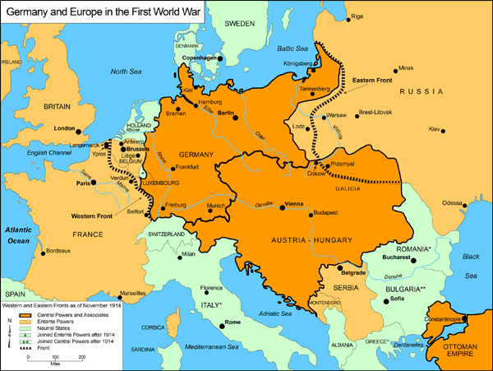

The Nation State and Sovereignty
Notes:
Nation-state: from Wikipedia: A nation state is a type of state that joins the political entity of a state to the cultural entity of a nation, from which it aims to derive its political legitimacy to rule and potentially its status as a sovereign state if one accepts the declarative theory of statehood as opposed to the constitutive theory.^{[1]} A state is specifically a political and geopolitical entity, whilst a nation is a cultural and ethnic one. The term "nation state" implies that the two coincide, in that a state has chosen to adopt and endorse a specific cultural group as associated with it. "Nation state" formation can take place at different times in different parts of the world.
Sovereignty
A nation-state accepts no political authority as superseding its own (within -- and sometimes beyond -- its borders)
Necessity of states respecting each other’s sovereignty

Slide 5
Security
“The first task of every government? The security of its citizens” (Brown and Smallman 156)
What is security?
Notes:
Smallman and Brown (156): ”Ultimately, what people fear determines how they define security.” But this means that security is an ever moving target, so to speak.
Security from what? Disease? Invading armies? Terrorism? Economic downtowns?

Slide 6
Role of Nation-State / Security
Source of power
Source of legitimacy
“Monopoly on violence”
Military and foreign policy
Notes:
Power: Definition:
The capacity to get others to do, or to stop doing, something (Naim, The End of Power, 1)
Source of legitimacy
Law and Order
“Monopoly on (“legitimate”) violence”
Protective space for life, business, trade, etc.
Police borders (enforces who can come in and out)
Immigration control
Military and national security
Defend sovereignty / not answer to others
Foreign policy
Prioritize and protect own national interests

Slide 7
Nation-State losing power?
Multinational corporations
Global financial markets
Rise of emerging economies
Offshoring
Recent global recession
Notes:
Multinational corporations
Outsourcing; global production sites
Perceptions of the impact of global trade markets
States no longer the master of global markets
Exchange rates all set by global markets, not by national policies
National economies seemingly shrinking into a single global economy
Recent global recession
Individual states dependent upon markets and policies in other nation-states
No individual nation-state can unilaterally act without repercussions being felt elsewhere (to varying degrees)
Need multilateral partnerships and dialogues

Slide 8


Threat of Globalization?
Is the nation-state losing relevance? Is it dying?
Malcom Waters, Globalization (2nd ed. 2001)
Manfred Steger, A Short Introduction to Globalization (2003)
Kenichi Ohmae, The Next Global Stage (2005)
Notes:
Malcom Waters, Globalization
Modern nations are all “cultural hybrids” (180)
Only a dozen of 180+ states have borders that coincide with a single ethnic or linguistic group
Waters: Globalization
Undermines territorial borders
Fosters cross-border identifications
Ethnic and other kinds of identification
Raises questions about future of nation-state
Ohmae
Nation-states little more than “bit actors” (Ohmae 214)
“The nation-state is increasingly a nostalgic fiction” (Ohmae 214)
“Nation-states are political organisms, and in their economic bloodstreams cholesterol steadily builds up. Over time, arteries harden and the organism’s vitality decays” (Ohmae 218).

Slide 9
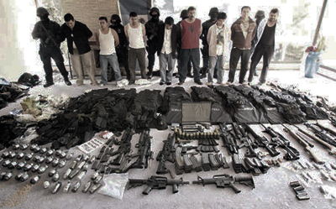
5 Wars of Globalization (Naim)
Drugs
Arms Trafficking
Intellectual Property
Alien Smuggling
Money Laundering
We can add a sixth war: Terrorism.
Notes:
The illegal trade in drugs, arms, intellectual property, people, and money is booming. Like the war on terrorism, the fight to control these illicit markets pits governments against agile, stateless, and resourceful networks empowered by globalization. Governments will continue to lose these wars until they adopt new strategies to deal with a larger, unprecedented struggle that now shapes the world as much as confrontations between nation-states once did.

Slide 10

Globalization and (Information) Technology
According to Nayan Chanda (2007), globalization is a historical phenomenon, but today’s globalization differs from the globalization of earlier eras through:
The velocity with which products and ideas are transferred;
the ever growing volume of consumers and products and their variety;
and the resultant increase in the visibility of this process
From Nayan Chanda Bound Together (2007) xii.
Notes:
The feeling of TODAY’S ERA of globalization’s impact appears different:
“Globalization refers to a multidimensional set of social processes that create, multiply, stretch, and intensify worldwide social interdependencies and exchanges while at the same time fostering in people a growing awareness of deepening connections between the local and the distant” (Steger 2003, 13).
“Facts and figures … do not matter because the issue is more psychological than one of economics” (Chanda Bound Together 2007, 296)

Slide 11
Has Power Lost Its Edge?
Moses Naim, The End of Power (2013)
The “More” Revolution
“Harder to control and coordinate”
The “Mobility” Revolution
“No more captive audience”
The “Mentality” Revolution
“Take nothing for granted”
Power is not dead, and coercion is still possible, but both have become more costly and harder to sustain over time. (Naim 73)
Notes:
More revolution: Naim: “Ours is an age of profusion. There is simply more of everything now. There are more people, countries, cities, political parties, armies; more goods and services, and more companies selling them; more weapons and more medicines; more students and more computers; more preachers and more criminals. The world’s economic output has increased fivefold since 1950. Income per capita is three and a half times greater than it was then. More importantly, there are more people – 2 billion more than just two decades ago. By 2050, the world’s population will be four times larger than it was in 1950.” (54)
The more revolution is also not limited geographically. It has also progressed despite wars, terrorism, economic recessions, disease, etc.
There is a larger global “middle” class, doubling in size from 1 billion in 1980 to 2 billion in 2012; more countries are now classified as “middle income countries” (56).
84 percent of the world’s population is now literate, compared to 75 percent in 1990. Combat deaths are down; life expectancy in most of the world is rising. Human beings are generally enjoying longer and healthier lives (57).
KEY: WHEN PEOPLE ARE MORE NUMEROUS AND LIVING FULLER LIVES, THEY BECOME MORE DIFFICULT TO REGIMENT AND CONTROL.
The mobility revolution: not just more people, but more people on the move. The UN estimates that there are 214 million migrants across the globe, an increase of 37% in the last two decades (59).
Brain drain and brain circulation as consequences. Whereas such migrations deprive countries of much needed nurses, engineers, scientists, entrepreneurs, etc., these people do not always cut off from their home countries. They return to work, send remittances, etc. In so doing, they “transfer the culture, approaches, and techniques” they learned abroad.
Money is also more mobile. Information is more mobile. Speed and extent of the drop in costs of moving goods, money, people, and information.
Urbanization – greater concentrations of people, greater clustering and availability of resources, opportunities, exchanges of knowledge, etc.
KEY: POWER NEEDS A CAPTIVE AUDIENCE; IF PEOPLE AND IDEAS AND MONEY ARE MORE MOBILE, IT IS HARDER FOR STATES TO COERCE CERTAIN BEHAVIORS, ATTITUDES, ETC.
Mentality revolution:
“Expectations revolutions”
People more mobile, with access to more information, greater discretionary spending, - there is an “emotional” impact of this greater access (65)
Greater attention to “standards” and “norms” and greater importance placed on transparency, human rights, and to fairness
“The ever-increasing salience of aspiration as a motivator of action and behavior” (69)
KEY: STATES AND OTHER TRADITIONAL POWER CENTERS CANNOT TAKE ANYTHING FOR GRANTED; THEIR POWER MAY BE CHALLENGED

Slide 12
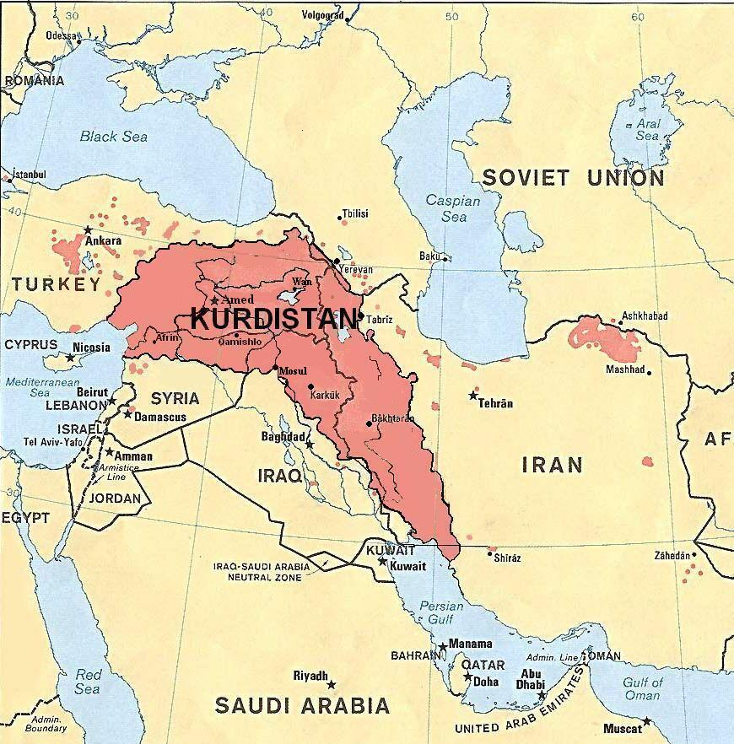
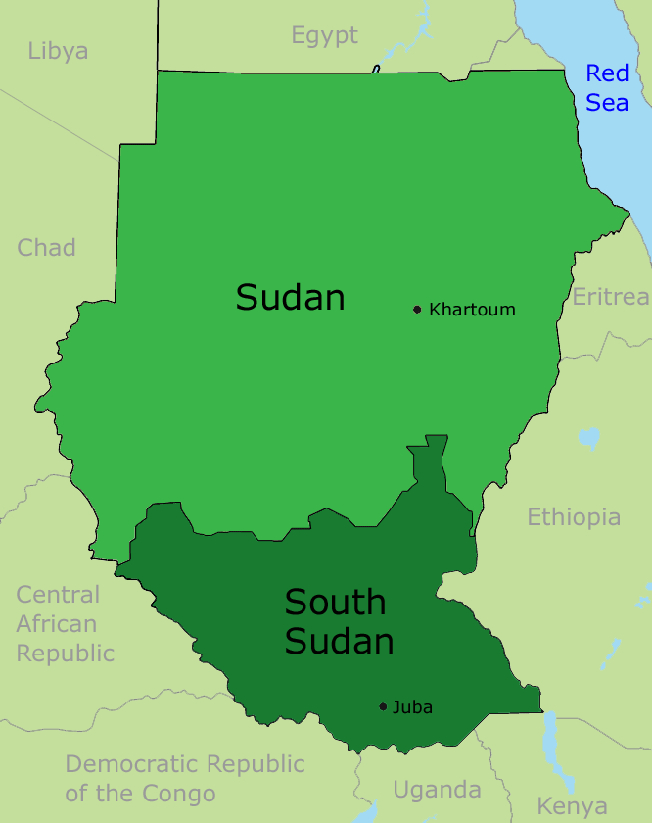
But, a reminder
Nation-states have ALWAYS faced existential threats from within and beyond borders
Social movements
Political movements
Non-violent and violent threats
Competing state and non-state actors
And power still attracts
Notes:
The self-preservation instincts of nation-states
Also, if nation-state is dying, why do separatist groups want their own nation-states? Exs: Kurdistan and South Sudan

Slide 13
The European Union: The Grand Experiment
Notes:
28 member states
“Pooling sovereignty”
The Eurozone (19 member states)
Schengen agreement
Free mobility of EU citizens throughout Europe
EU values of “solidarity” and “model for humanitarian assistance”
On most foreign policy issues, unanimous consent of all member states necessary
Dublin Regulation (2013)
Dublin Regulation (2013)
EU country in which asylum first arrives is responsible for processing asylum claim

Slide 14
Eurozone and Schengen

Slide 15
Brexit
Notes:
Referendum on June 23, 2016: Slight majority votes for UK to leave the European Union. Why?
Fears of immigration
Anger at “Brussels” and “one-size fits all” policies
Anger at loss of national sovereignty
“Restore” national power and sovereignty of the UK
FAZIT: A push back, albeit not a strong one, against the pooling of sovereignty in the EU

Slide 16
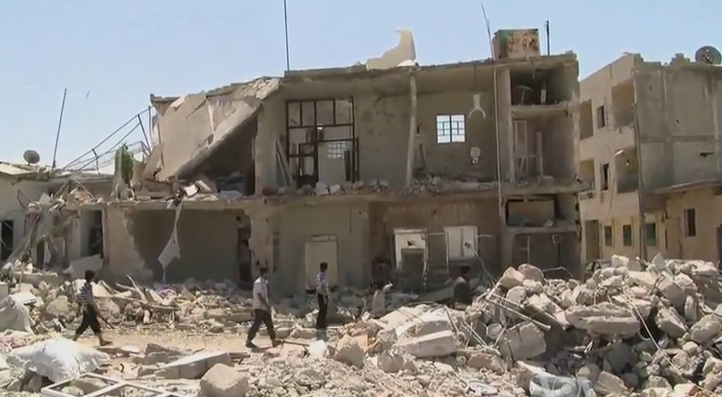
The Civil War in Syria and its Implications
Notes:
Civil War in Syria since 2011
Within country: 7.6 million Syrians displaced
4 million Syrians have fled country
635,000 registered in Jordan (pop. of 6 million)
1.1million registered in Lebanon (pop. of 4.3 million)
2.5 million registered in Turkey (pop. 72 million)
(numbers from Amnesty International)

Slide 17
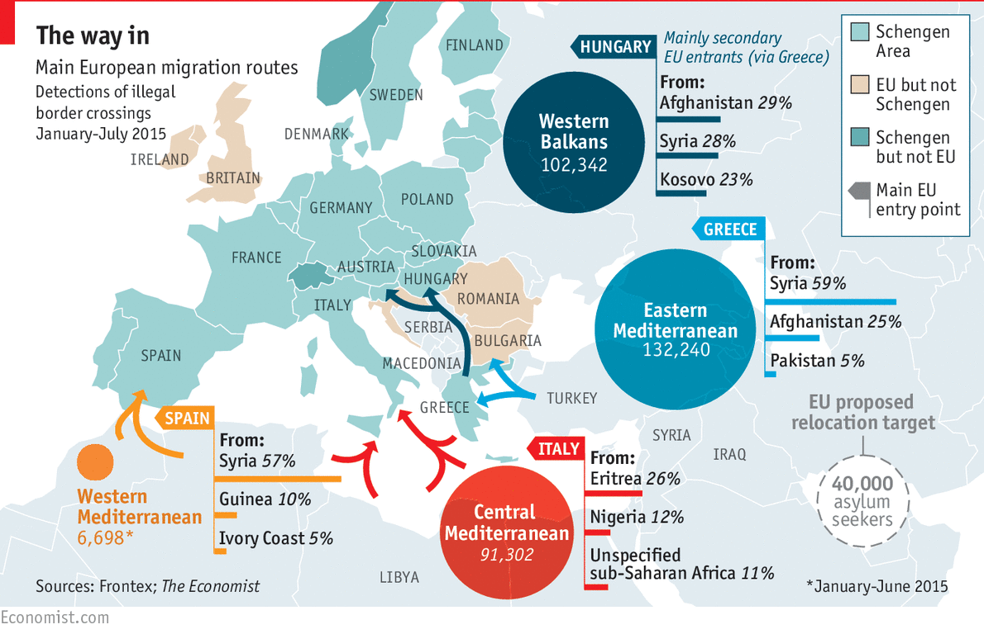
Refugee Crisis in Europe

Slide 18
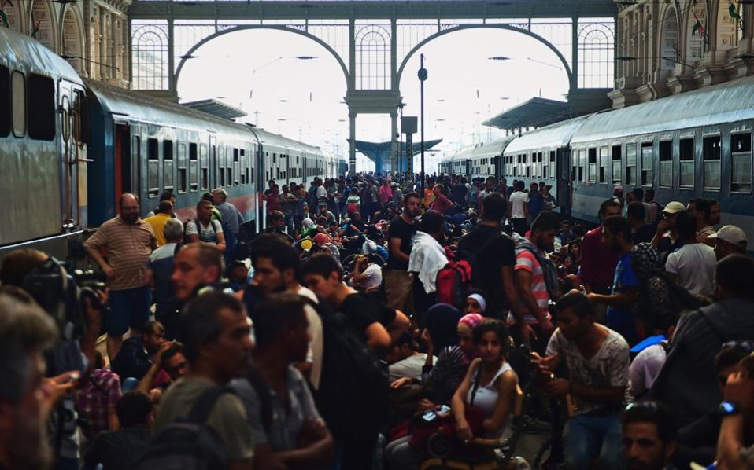
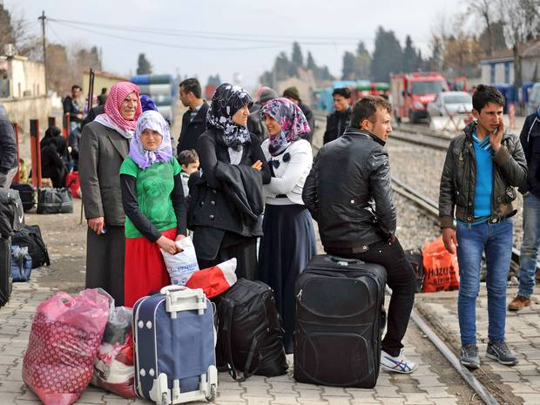
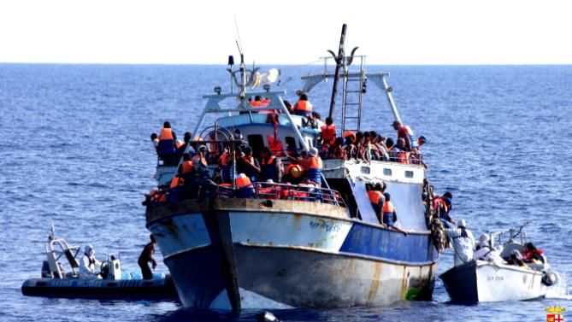
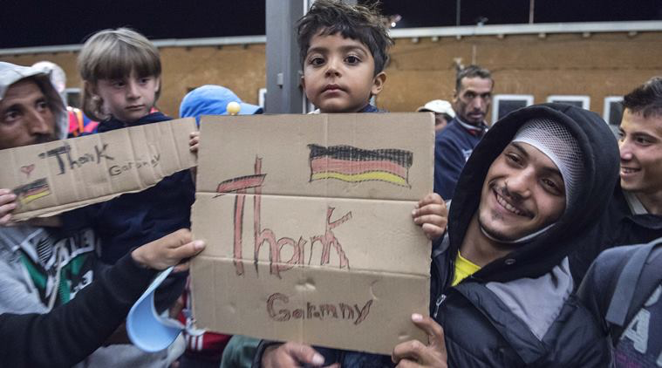
Images

Slide 19
Brief tangent: Human Rights
From the United Nations:
Human rights are rights inherent to all human beings, whatever our nationality, place of residence, sex, national or ethnic origin, color, religion, language, or any other status. We are all equally entitled to our human rights without discrimination. These rights are all interrelated, interdependent and indivisible.
From Humanrights.com
Human rights are based on the principle of respect for the individual. Their fundamental assumption is that each person is a moral and rational being who deserves to be treated with dignity. They are called human rights because they are universal. Whereas nations or specialized groups enjoy specific rights that apply only to them, human rights are the rights to which everyone is entitled—no matter who they are or where they live—simply because they are alive.
Notes:
What do these definitions tell us? Rights are UNIVERSAL, but do we get into specifics here?
There are three overarching types of human rights norms: civil-political, socio-economic, and collective-developmental (Vasek, 1977). The first two, which represent potential claims of individual persons against the state, are firmly accepted norms identified in international treaties and conventions. The final type, which represents potential claims of peoples and groups against the state, is the most debated and lacks both legal and political recognition.
Civil-political human rights include two subtypes: norms pertaining to physical and civil security (for example, no torture, slavery, inhumane treatment, arbitrary arrest; equality before the law) and norms pertaining to civil-political liberties or empowerments (for example, freedom of thought, conscience, and religion; freedom of assembly and voluntary association; political participation in one's society).
Socio-economic human rights similarly include two subtypes: norms pertaining to the provision of goods meeting social needs (for example, nutrition, shelter, health care,
education) and norms pertaining to the provision of goods meeting economic needs (for example, work and fair wages, an adequate living standard, a social security net).
Finally, collective-developmental human rights also include two subtypes: the self determination of peoples (for example, to their political status and their economic, social, and cultural development) and certain special rights of ethnic and religious minorities (for example, to the enjoyment of their own cultures, languages, and religions). (1998: 272)
Factors in discussing human rights:
How do these factors affect how we talk about human rights?
Age: greater sympathy for younger people?
Gender: greater sympathy for women?
Socio-economic status: do poor generate more sympathy or less?
Geographic origins: where people come from? Does this matter? Consider war refugees from Bosnia-Herzogovina in the 1990s vs. Syrians today.
Race and ethnicity: do people look like us?
What generates sympathy and concern?

Slide 20
Important Terms and Numbers
Terms: Migrant, asylum-seeker, refugee
German estimate: 1.1 million migrants in Germany in 2015
Syrians, Eritreans, Sudanese, People from Balkan countries (Albania, Macedonia, etc), etc.
476,679 asylum applications in Germany (34% from Syria)
Logistical challenges
Notes:
Migrant: mobile person seeking opportunities in other country
Asylum seeker – seeking asylum (protection) and residency in foreign country (fleeing some kind of persecution or conflict)
Refugee – legal status – when a person is legally defined as refugee – entitled to protections, can’t be sent back, etc.
Logistical challenges: distribution of refugee population, housing, food, medical care, employment, language instruction, “integration”

Slide 21
The Refugee Crisis in Context of Key Terms
Globalization
Security
Realism (Realpolitik) / Interventionism / Human Security
Human Rights
Terrorism
Huntington: Clash of Civilizations?
Sovereignty
Solidarity and the European Union?
Is the EU’s future in doubt?
Notes:
Globalization: migrations a manifestation of several factors related to globalization:
Knowledge of other possibilities and opportunities / building off of previous migrations (labor mobility)
Refugees entering into European Union space with the EU a product created in response to and as part of trends of globalization. Open borders – promote mobility of goods, services, and ideas. Share responsibility and pool sovereignty for “greater good” of European population. Less emphasis on nation-state.
Realism: complex concept. In general, proponents typically view security as key issue in international affairs. State as the key role/player. More pessimistic about human nature and the inevitability of conflict. International system is anarchic, and countries act in their national interest (regardless of how they couch the motivations). Strategy of Realpolitik: allliance formation and power balancing based on calculated self interest. In terms of the EU, Realism should not be a factor. But how countries are responding appears to confirm Realists.
Interventionism: liberal form – human rights catastrophe – must intervene. Neoconservative – may couch in such rhetoric, but also intervention to prevent something worse happening or threats (doctrine of prevention). In this case: externally – intervene in Syria for humanitarian reasons? For security reasons. Internally: states and EU must act to solve the problem within the EU borders.
Human Security: define threats by what endangers not just the state, but also the individual. Not just military security, but health security, economic security as it pertains to the individual.
Human rights: framing the crisis in terms of the human tragedy and the assault on the rights and opportunities of those afflicted. If every individual life is sacred and each person enjoys inalienable natural rights, does that not mean that action to protect everyone must be taken.
Terrorism: fears of terrorists “sneaking in” or becoming radicalized
Huntington: Clash of Civilizations thesis – religioius and cultural ideologies in conflict. Religious pluralism, secularism, individual autonomy, equal rights for men and women etc. vs. patriarchal and religious values.
SOVEREIGNTY: the problem here
In EU context, the solution to the challenges should be based on notions of SOLIDARITY. Member states should share the burden. But 1) the burden is so great, and 2) many member states want nothing to do with sharing the burden for domestic political reasons, fears of terrorism, concerns about threats to culture and way of life (ethnicity, race, etc.)
AS A RESULT: “retreat” into national interests
Poland: we will not take anybody. Hungary – we are building fences to keep people out
Racism, xenophobia
Rise of populist political parties. AfD in Germany – winning up to 25% in state elections
Sovereignty: the EU cannot compel countries to act; also, no path to agreement within the EU
Power: opportunities to assert power by countries such as Hungary. Merkel and Germany: no ability to compel other countries to cooperate except for calls for “solidarity.”
Questions of “accountability”
Politicians elected nationally
EU political mechanisms based on consensus building from member states
Deals with ethical quandaries
EU-Turkey agreement. Up to 6 billion Euros in financial support. Expedited negotiations for EU membership. In return, Turkey keeps millions of refugees in its borders (camps).
But Turkish government jailing dissidents, journalists, thinking of reinstituting the death penalty, fighting Kurds, etc.
Deal made to keep refugees out of EU, but at what ethical cost?

Slide 22
The Takeaways
Global conflicts and challenges
Limitations on nation-states
Need for cooperation
Resistance to “globalizing” trends and features
The nation-state on the rebound?
Notes:
Global conflicts and challenges
Extend beyond boundaries of individual nation-states
No single nation-state can solve these conflicts and challenges
Nation-states limited by borders, bureaucracies, market forces, sovereignty of other states, etc.
But nation-states must act together to combat these challenges
Overcome particular interests and motives for greater global good. But this is not easy (and sometimes not possible)

Slide 23
Reminders
Tonight: "Responding to ISIS: Saving Cultural Heritage in Iraq and Syria"
7:30 PM in Chan Auditorium (Business Administration Building)
Second Midterm:
Extension of due date until November 6 (Sunday) at 11:59pm
Exam ready by this Thursday
November 1: Yaa Gyasi event

